Slide 1
Web Technologies
Browser Object Model
Document Object Model

Slide 2
Summary of Today’s Lecture
Browser Object Model (BOM)
  Window object properties
  Window object methods
  Window Events
Document Object Model (DOM)
  Accessing DOM Nodes
  DOM Events

Slide 3
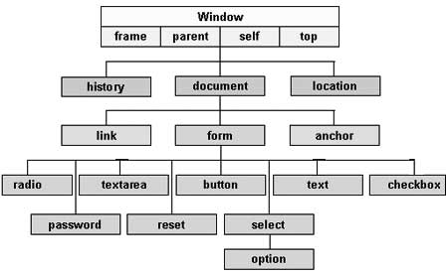
Browser Object Model
The Browser Object Model (BOM) is used to interact with the browser.
The default object of browser is window. The window object represents a window in browser. An object of window is created automatically by the browser.
Even the document object (of the HTML DOM) is a property of the window object:

Slide 4
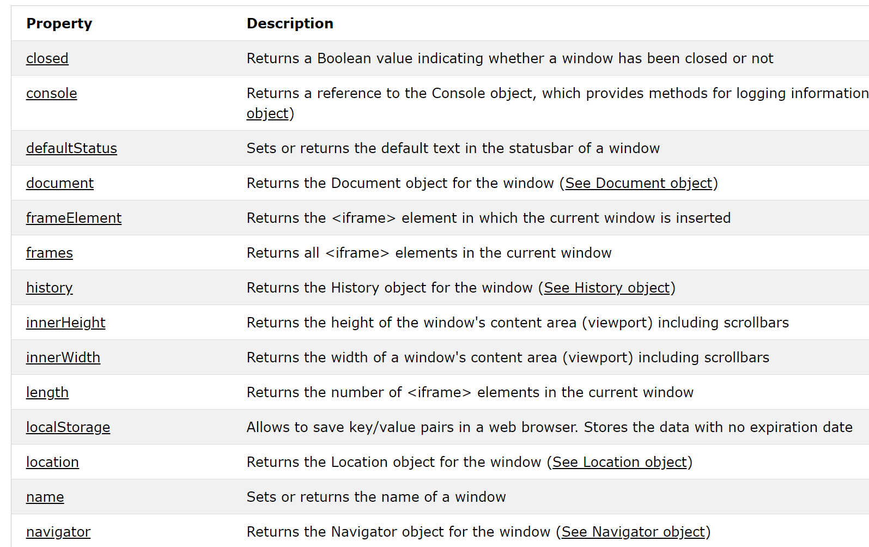
Window Object Properties
In JavaScript, the browser is known as the window object.
The window object has a number of properties and methods that we can use to interact with it.

Slide 5
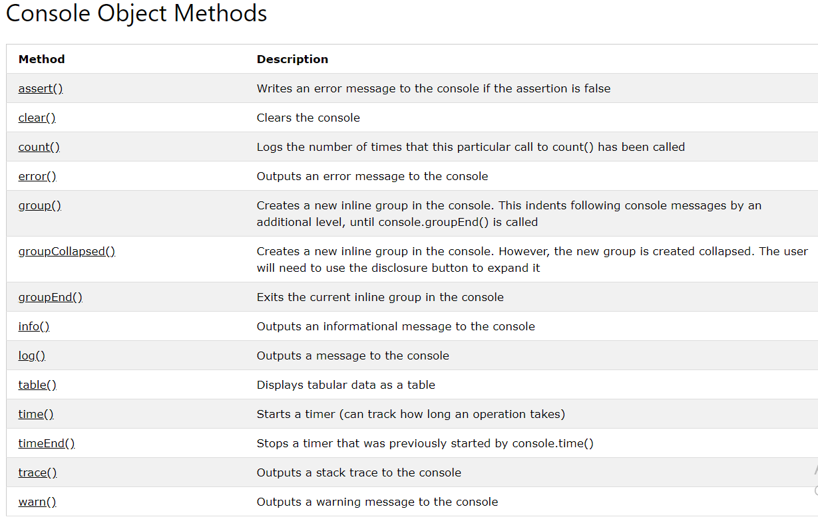
Window console Object - Example
The console object provides access to the browser's debugging console.

Slide 6
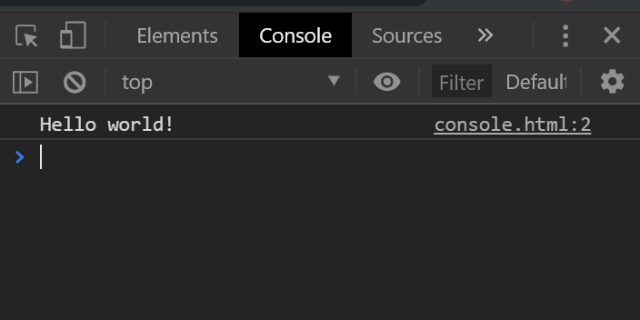
Window console.log() method
The console.log()method writes a message to the console.
For example, if you write following JavaScript statement, then its console output will be:
console.log("Hello world!");

Slide 7
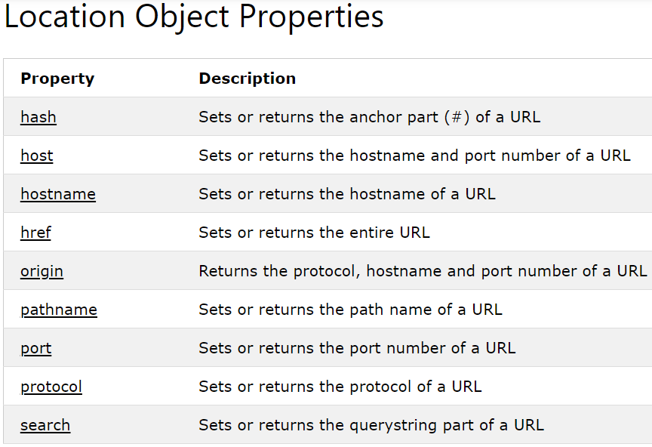
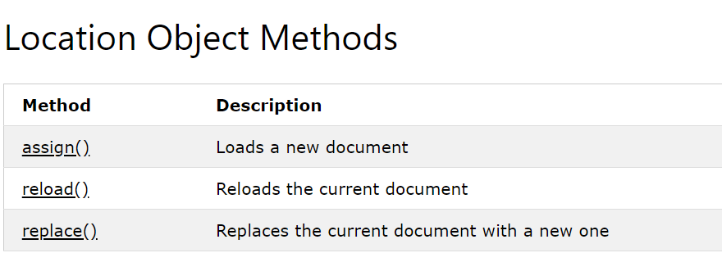
Window location Object - Example
The location object contains information about the current URL.
The location object is part of the window object and is accessed through the window.location property.
The following statement redirects user to www.comsats.edu.pk.
  window.location.assign("http://www.comsats.edu.pk");

Slide 8
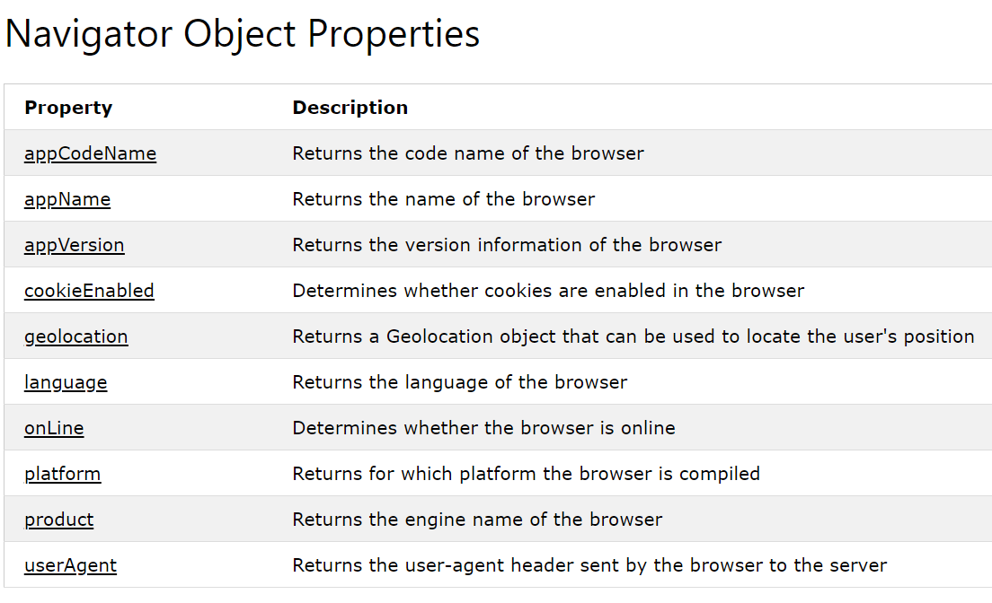
Window navigator Object - Example
The navigator object contains information about the browser.
The following statement returns the name of browser.
  var x = "Browser Name: " + navigator.appName;

Slide 9
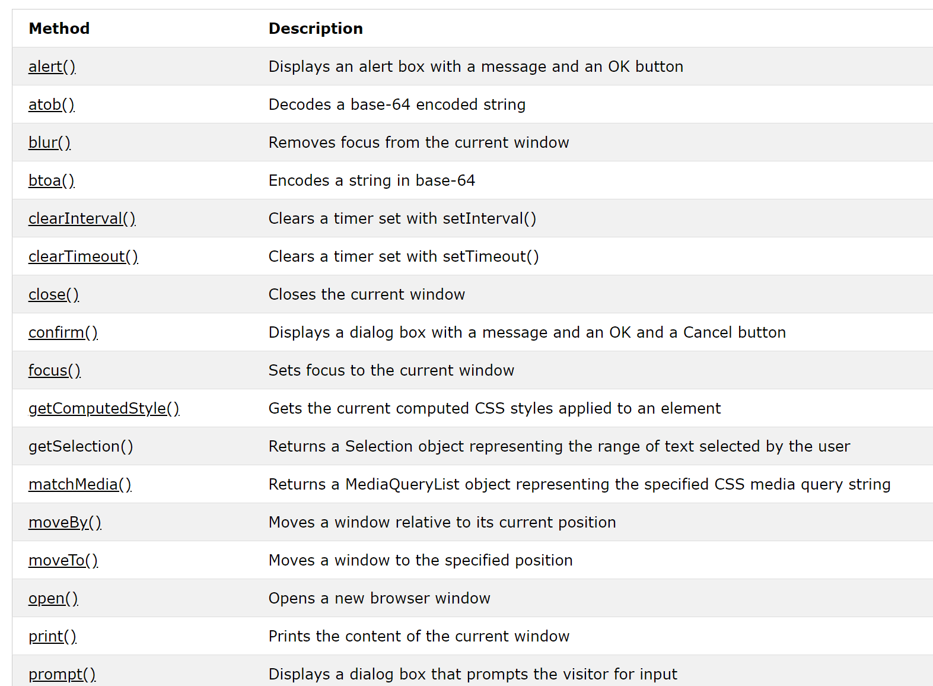
Windows Object Methods

Slide 10
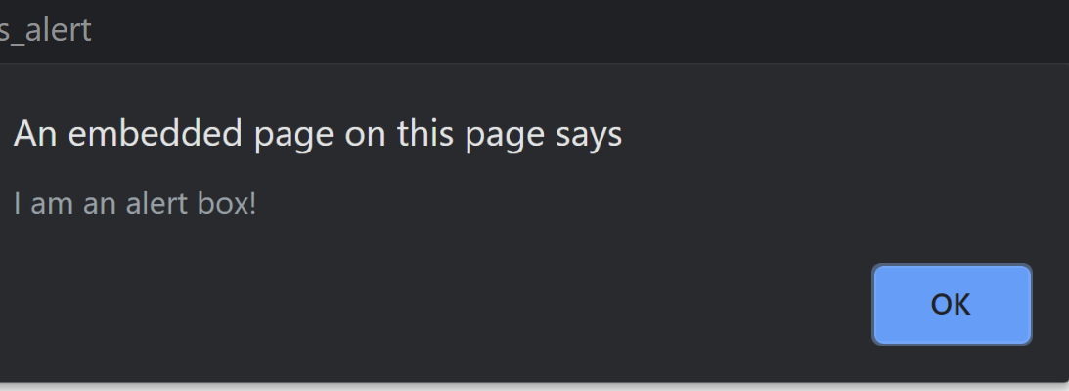
alert()
The alert()method displays an alert box with a specified message and an OK button.
An alert box is often used if you want to make sure information comes through to the user.
<!DOCTYPE html>
<html>
<body>
<h2>JavaScript Alert</h2>
<button onclick="myFunction()">Try it</button>
<script>
function myFunction() {
alert("I am an alert box!");
}
</script>
</body>
</html>

Slide 11
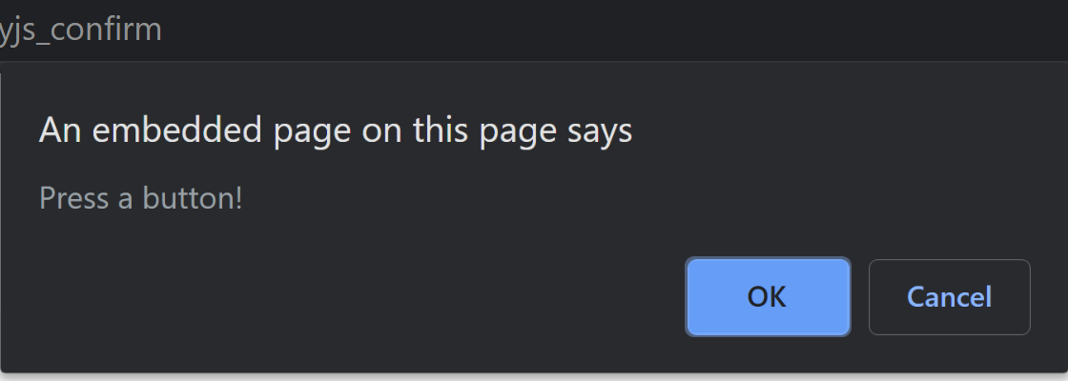
confirm()
The confirm()method displays a dialog box with a specified message, along with an OK and a Cancel buttons.
A confirm box is often used if you want the user to verify or accept something.
The confirm()method returns true if the user clicked "OK", and false otherwise.
<body>
<h2>JavaScript Confirm Box</h2>
<button onclick="myFunction()">Try it</button>
<p id="demo"></p>
<script>
function myFunction() {
if (confirm("Press a button!")) {
alert("You pressed OK!"); }
else {
    alert(" You pressed Cancel!"); }
}
</script>
</body>

Slide 12
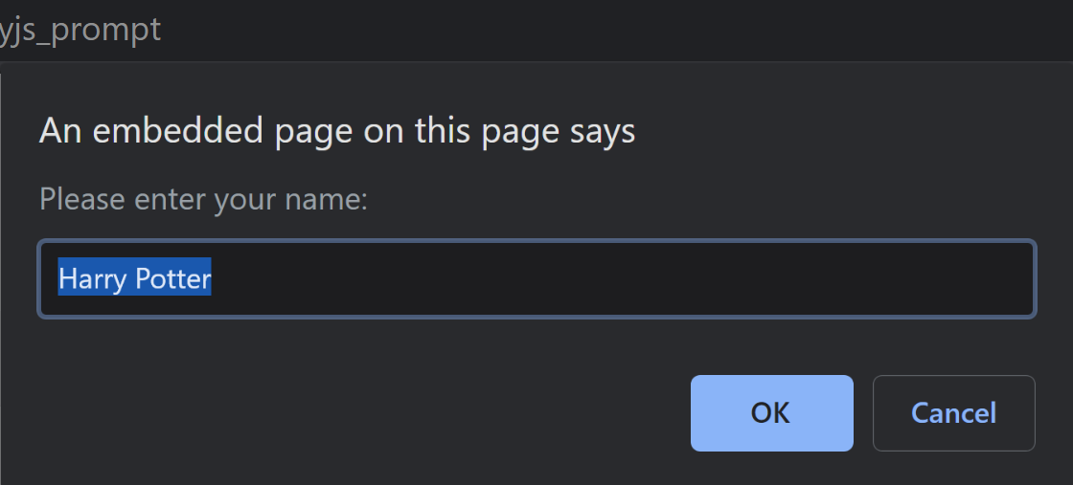
prompt()
The prompt()method displays a dialog box that prompts the visitor for input.
The prompt()method returns the input value if the user clicks "OK". If the user clicks "cancel" the method returns null.
<body>
<h2>JavaScript Prompt</h2>
<button onclick="myFunction()">Try it</button>
<p id="demo"></p>
<script>
function myFunction() {
var person = prompt("Please enter your name:", "Harry Potter");
if (person == null) {
alert("User cancelled the prompt.");}
else {
alert("Hello " + person + "! How are you today?"); }
}
</script>
</body>

Slide 13
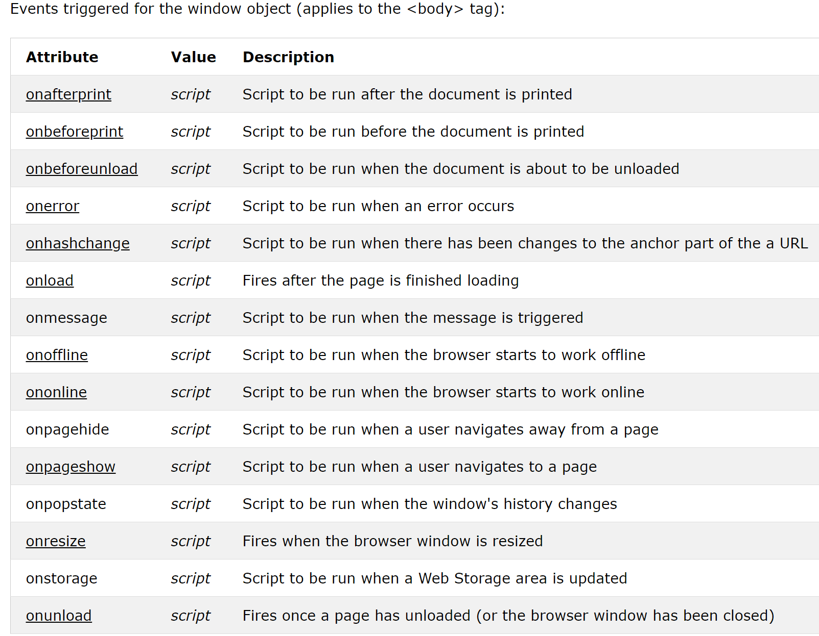
Windows Events

Slide 14
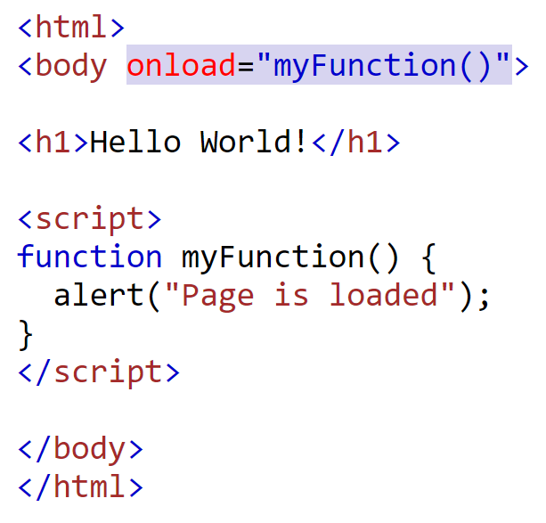
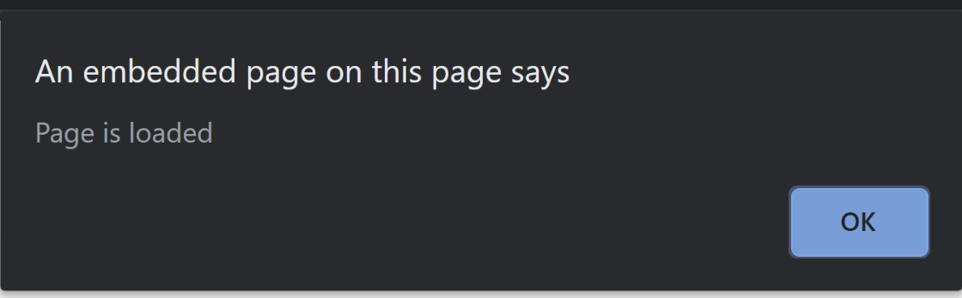
Window onload()event- Example
The onload event occurs when an object has been loaded.
onload is most often used within the <body> element to execute a script once a web page has completely loaded all content (including images, script files, CSS files, etc.).
Output

Slide 15
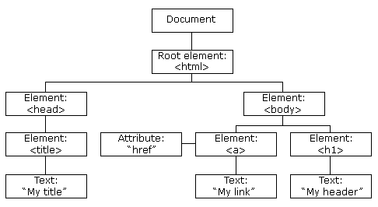
Document Object Model
The Document Object Model, or DOM for short, is a platform and language independent model to represent the HTML or XML documents.
It represents the web page that is loaded into the browser using a series of objects.
In the DOM, all parts of the document, such as elements, attributes, text, etc. are organized in a hierarchical tree-like structure; like a family tree in real life that consists of parents and children. In DOM terminology these individual parts of the document are known as nodes.
The DOM is a collection of nodes:
Element nodes
Attribute nodes
Text nodes
Comment Nodes

Slide 16
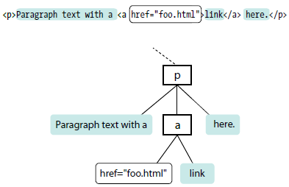
Example DOM tree
<html>
  <head>
    <title>Document title</title>
    <meta charset="utf-8">
  </head>
  <body>
    <div>
      <h2>Subhead</h2>
      <p>Paragraph text with a
      <a href="foo.html">link</a> here.</p>
    </div>
    <div>
      <p>More text here.</p>
    </div>
  </body>
</html>

Slide 17
DOM Document Object
When an HTML document is loaded into a web browser, it becomes a document object.
The document object is the root node of the HTML document.
To access the different objects in the DOM, we start with the document object, working down to the object that holds the data you are after.
Each object is separated by a period; hence, this is known as a dot notation.
Following are the DOM methods to be discussed in subsequent slides.
  Finding HTML elements by id ( getElementById())
  Finding HTML elements by class name ( getElementsByClassName())
  Finding HTML elements by tag name ( getElementsByTagName())
  Finding HTML elements by CSS selectors
    querySelector()
    querySelectorAll()
  Finding HTML elements by HTML object collections (document.forms)

Slide 18
Accessing Element Nodes
  Finding HTML elements by id ( getElementById())
    The easiest way to find an HTML element in the DOM, is by using the element id.
    This example finds the element with id="intro":
    var myElement = document.getElementById("intro");
  Finding HTML elements by class name ( getElementsByClassName())
    If you want to find all HTML elements with the same class name, use getElementsByClassName().
    This example returns a list of all elements with class="intro".
    var x = document.getElementsByClassName("intro");
  Finding HTML elements by tag name ( getElementsByTagName())
    This example finds all <p> elements:
    var x = document.getElementsByTagName("p");

Slide 19
Accessing Element Nodes
  Finding HTML elements by CSS selectors (querySelector())
  If you want to find first HTML element that matches a specified CSS selector (id, class names, types, attributes, values of attributes, etc), use the querySelector() method.
  This example returns first <p> element with class="intro".
  var x = document.querySelector("p.intro");
  Finding HTML elements by CSS selectors (querySelectorAll())
    If you want to find all HTML elements that match a specified CSS selector (id, class names, types, attributes, values of attributes, etc), use the querySelectorAll() method.
    This example returns a list of all <p> elements with class="intro".
    var x = document.querySelectorAll("p.intro");

Slide 20
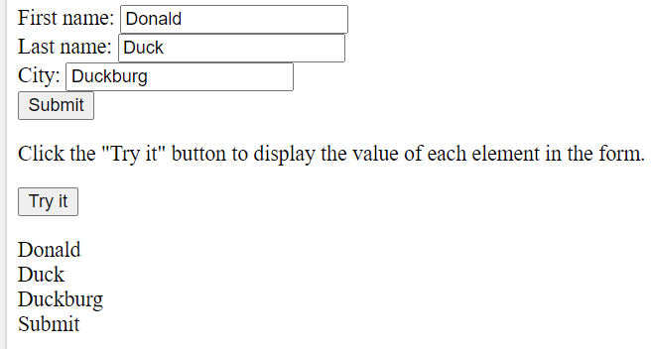
Accessing Element Nodes
Finding HTML elements by HTML object collections (document.forms)
This example finds the form element with id="frm1", in the forms collection, and displays all element values:
  var elements = document.forms["frm1"];
  var text = "";
  var i;
  for (i = 0; i < elements.length; i++) {
  text += elements[i].value + "<br>";
  }
  document.getElementById("demo").innerHTML = text;
  <p id="demo"></p>
The following HTML objects (and object collections) are also accessible:
document.anchors
document.body
document.documentElement
document.embeds
document.forms
document.head
document.images
document.links
document.scripts
document.title
Output

Slide 21
DOM Get/ Set HTML Content
The innerHTML property sets or returns the HTML content (innerHTML) of an element.
Return the innerHTML property:
  Syntax: HTMLElementObject.innerHTML
  Get the HTML content of a <p> element with id="myP":
  var x = document.getElementById("myP").innerHTML;
Set the innerHTML property:
  Syntax: HTMLElementObject.innerHTML = text
  Change the HTML content of a <p> element with id="demo":
  document.getElementById("demo").innerHTML = "Paragraph changed!";
  If we need a quick way of adding a paragraph of text to the first element on our page with a class of intro:
  document.getElementsByClassName("intro"). innerHTML =“<p>This is our intro text</p>";

Slide 22
DOM Get/ Set Input Controls Content
The value property sets or returns the content of input controls.
Return the value property:
  Syntax: textObject.value
  Get the value of a text field:
    var x = document.getElementById("myText").value;
  Return the value of a selected option in a drop-down list:
    var x = document.getElementById("mySelect").value;
  Get the value of the value attribute of a radio button:
    var x = document.getElementById("myRadio").value;
Set the value property:
  Syntax: textObject.value = text
  Change the value of a text field:
    document.getElementById("myText").value = "Johnny Bravo";
  Change the contents of a text area:
    document.getElementById("mySelect").value = "banana";
  Change the value of the value attribute of a radio button:
    document.getElementById("myRadio").value = "newRadioBtnValue";

Slide 23
DOM Get/ Set Attributes
JavaScript provides several methods for adding, removing or changing an HTML element's attribute.
Getting Element's Attribute Value (getAttribute())
  The getAttribute() method is used to get the current value of a attribute on the element.
  This example gets the value of the src attribute of an <img> element:
  document.getElementById("image").getAttribute("src")
    Setting Attributes on Elements (setAttribute())
    The setAttribute() method is used to set an attribute on the specified element.
      This method requires two arguments: the attribute to be changed and the new value for that attribute.
      The following example sets the value of the src attribute of an <img> element to newimg.jpg:
      document.getElementById("image"). setAttribute("src", “newimg.jpg");

Slide 24
DOM Get/Set CSS Inline Styles
In JavaScript the style property is used to get or set the inline style of an element.
You get the styles applied on the HTML elements using the style property.
  Syntax: document.getElementById(id).style.property
  The following example get the style of a <p> element:
  var x = document.getElementById("p2").style.color;
To change the style of an HTML element, use this syntax:
  Syntax: document.getElementById(id).style.property = new style
  The following example changes the style of a <p> element:
  document.getElementById("p2").style.color = "blue";

Slide 25
DOM Events
An event is an action that can be detected with JavaScript, such as when the document loads or when the user clicks on an element or just moves her mouse over it.
In scripts, an event is identified by an event handler. For example, the onload event handler triggers a script when the document loads.
Similarly onclick and onmouseover handlers trigger a script when the user clicks or mouses over an element, respectively.
There are three common methods for applying event handlers to items within our web pages:
  As an HTML attribute
  As a method attached to the element
  Using addEventListener() method

Slide 26
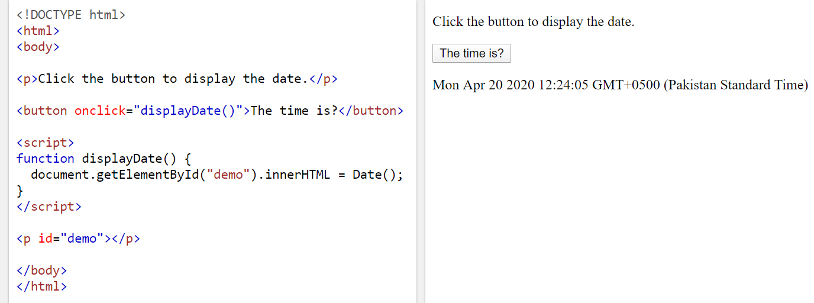
As an HTML attribute
HTML event attribute can be used to assign events to HTML elements.
It should be avoided for the same reason we avoid using style attributes in our markup to apply styles to individual elements.

Slide 27
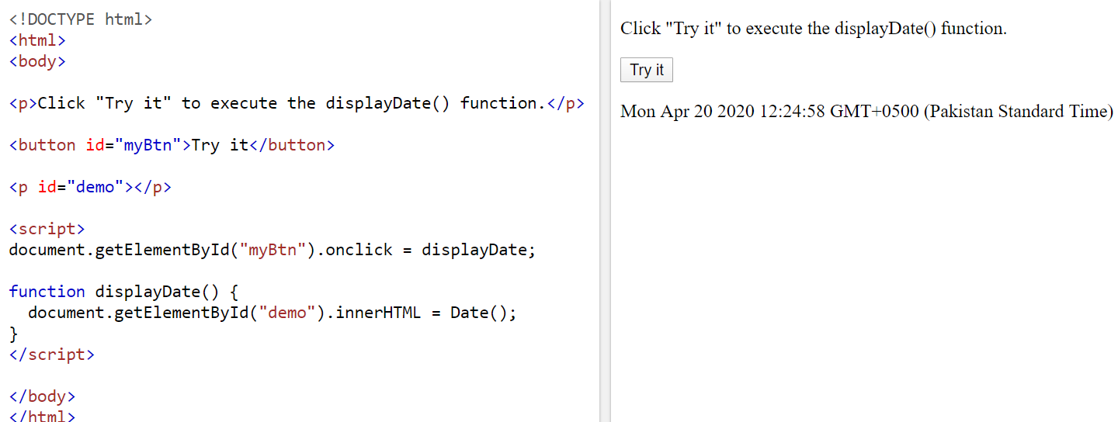
As a method attached to the element
The HTML DOM also allows to assign events to HTML elements using JavaScript:

Slide 28
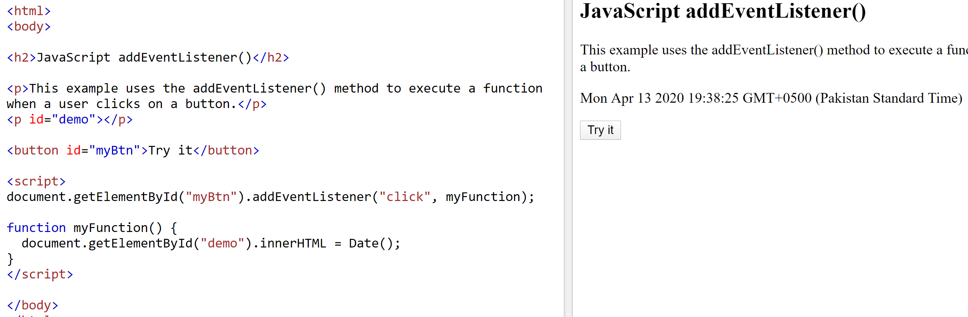
Using addEventListener()method
The addEventListener()method attaches an event handler to the specified element.
The addEventListener()method attaches an event handler to an element without overwriting existing event handlers, i.e two "click" events.
Syntax:
  element.addEventListener(event, function, useCapture);
  The first parameter is the type of the event (like "click" or "mousedown" or any other HTML DOM Event.)
  The second parameter is the function we want to call when the event occurs.
  The third parameter is a boolean value specifying whether to use event bubbling or event capturing. This parameter is optional.

Slide 29
Event Bubbling vs Event Capturing
There are two ways of event propagation in the HTML DOM, bubbling and capturing.
Event propagation is a way of defining the element order when an event occurs. If you have a <p> element inside a <div> element, and both having click event attached to them.
Now when the user clicks on the <p> element, which element's "click" event should be handled first?
  In bubbling the inner most element's event is handled first and then the outer: the <p> element's click event is handled first, then the <div> element's click event.
  In capturing the outer most element's event is handled first and then the inner: the <div> element's click event will be handled first, then the <p> element's click event.
  The default value is false, which will use the bubbling propagation, when the value is set to true, the event uses the capturing propagation.

Slide 30
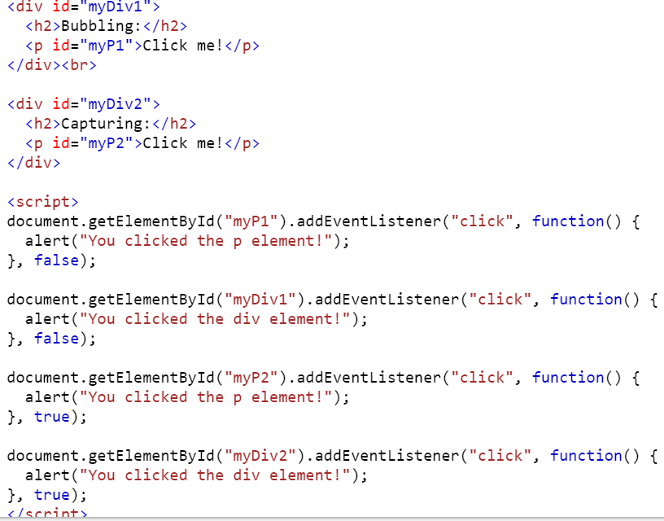
Event Bubbling vs Event Capturing

Slide 31
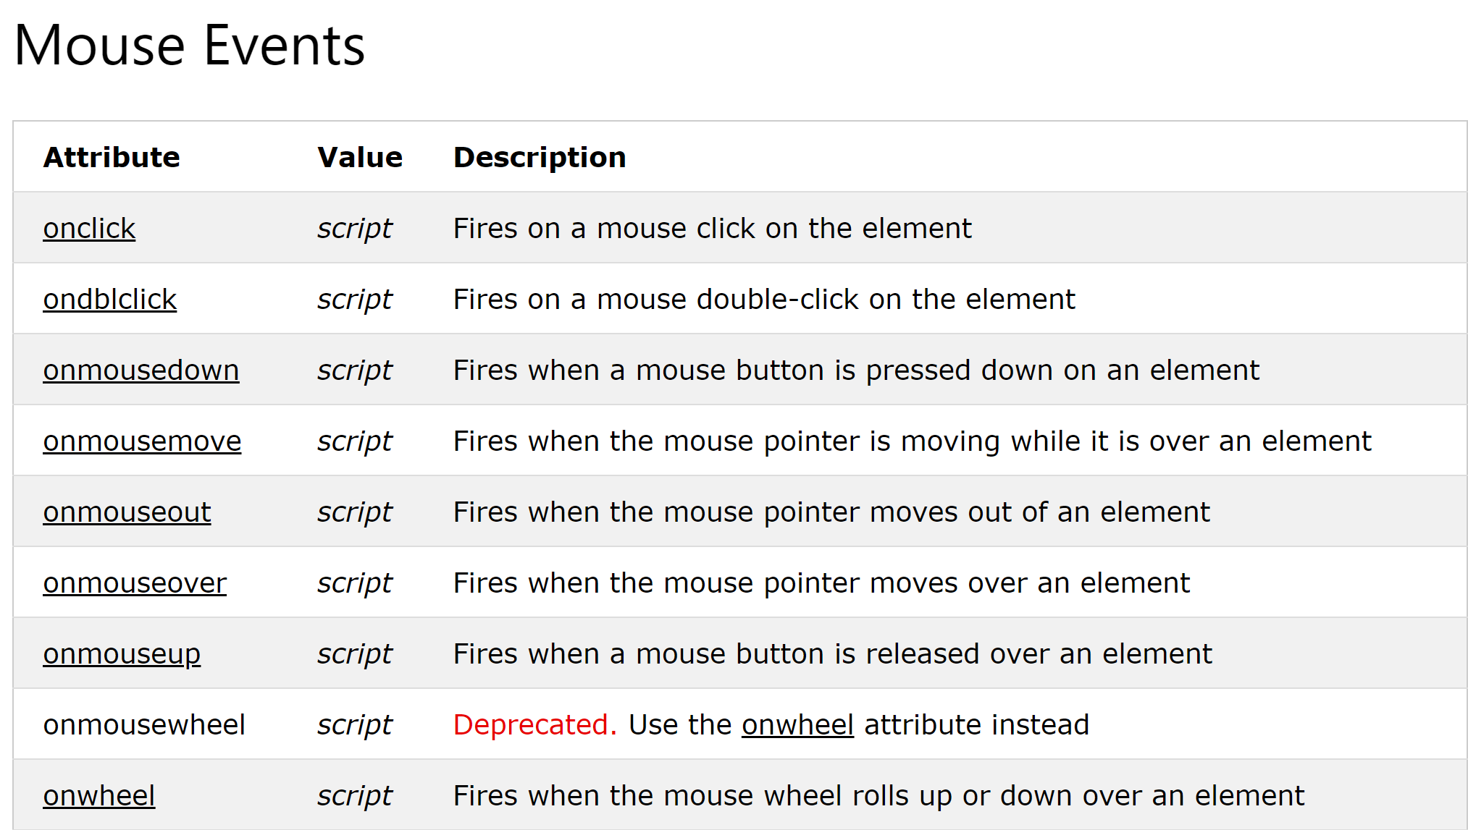
Mouse Events

Slide 32
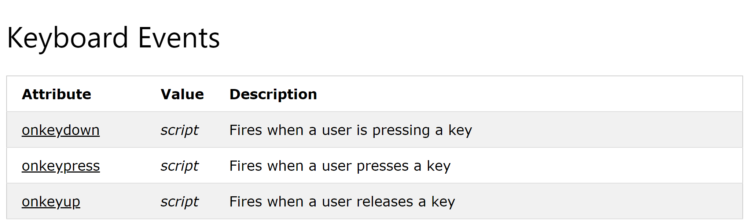
Keyboard Events

Slide 33
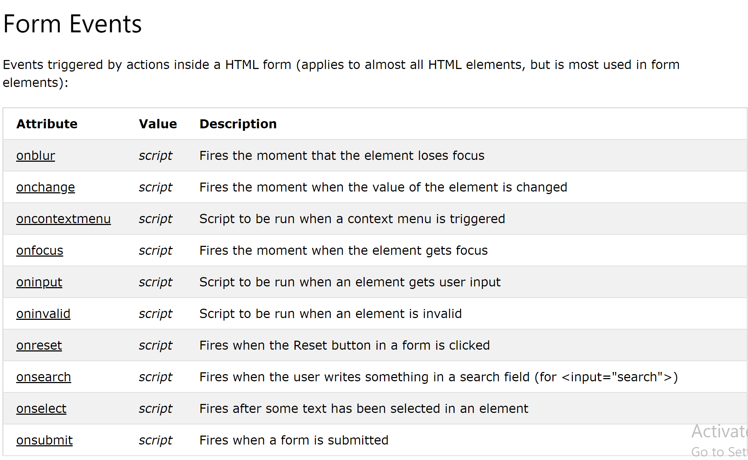
Form Events

Slide 34
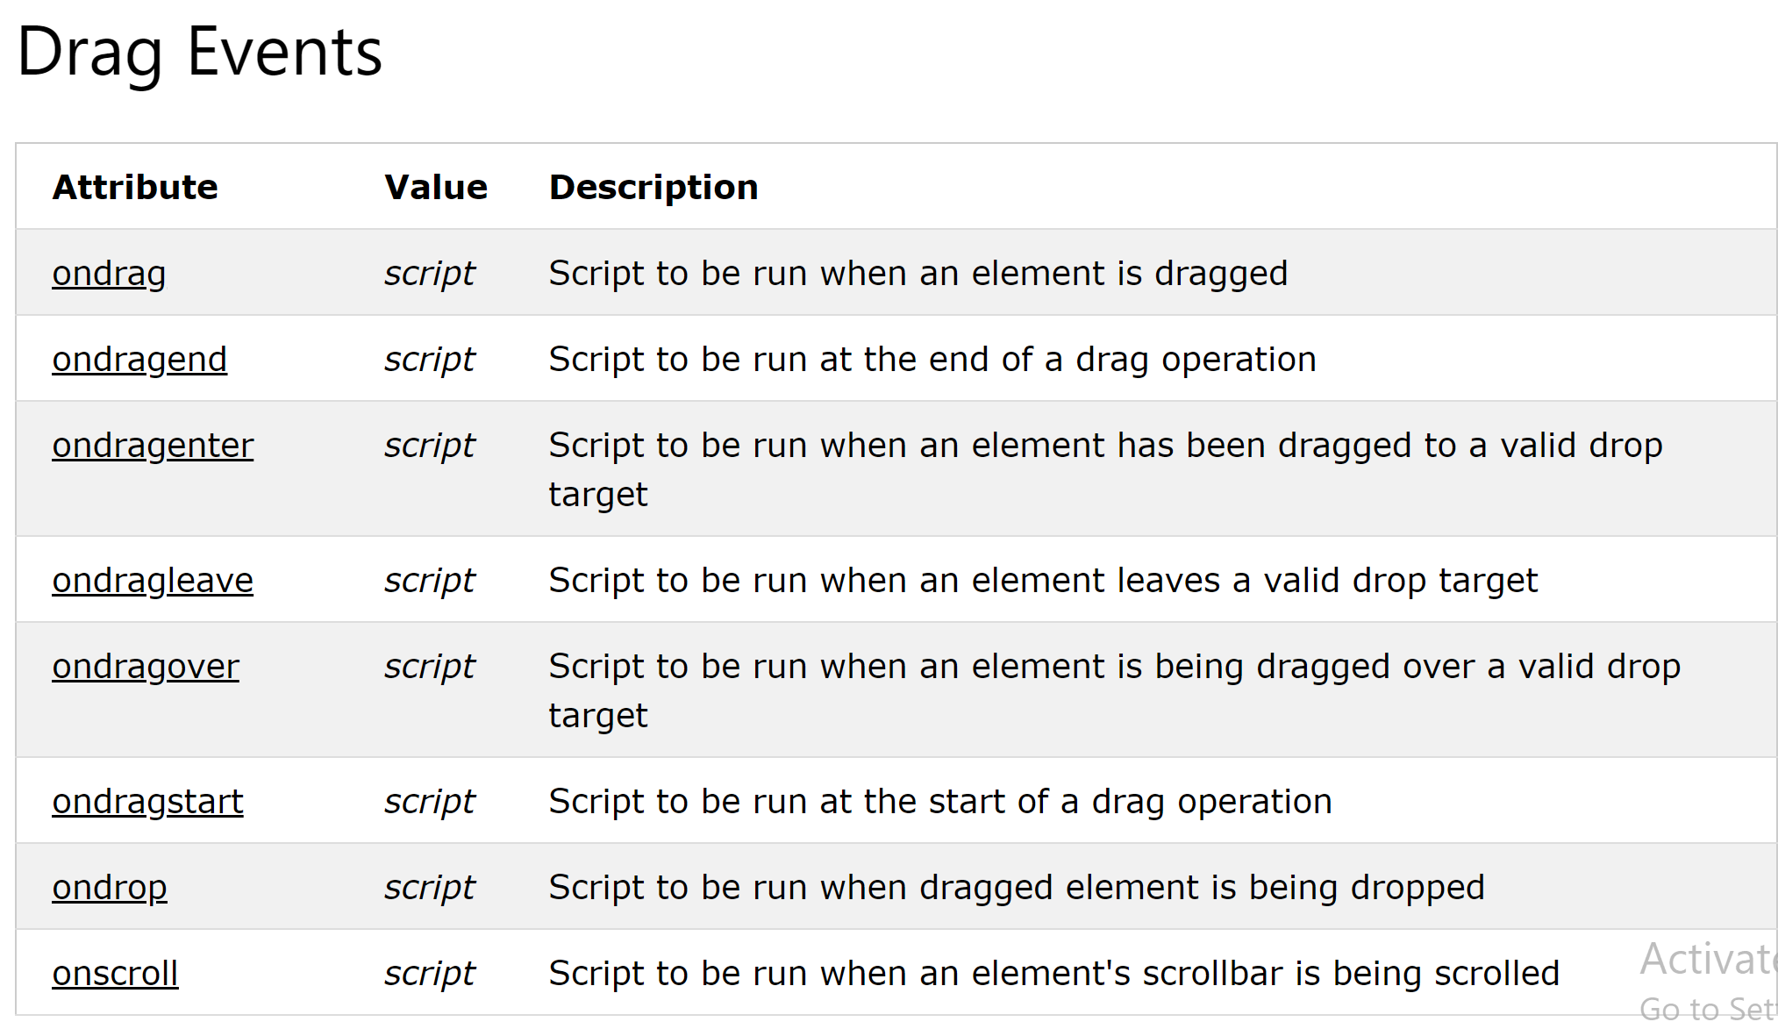
Drag Events

Slide 35
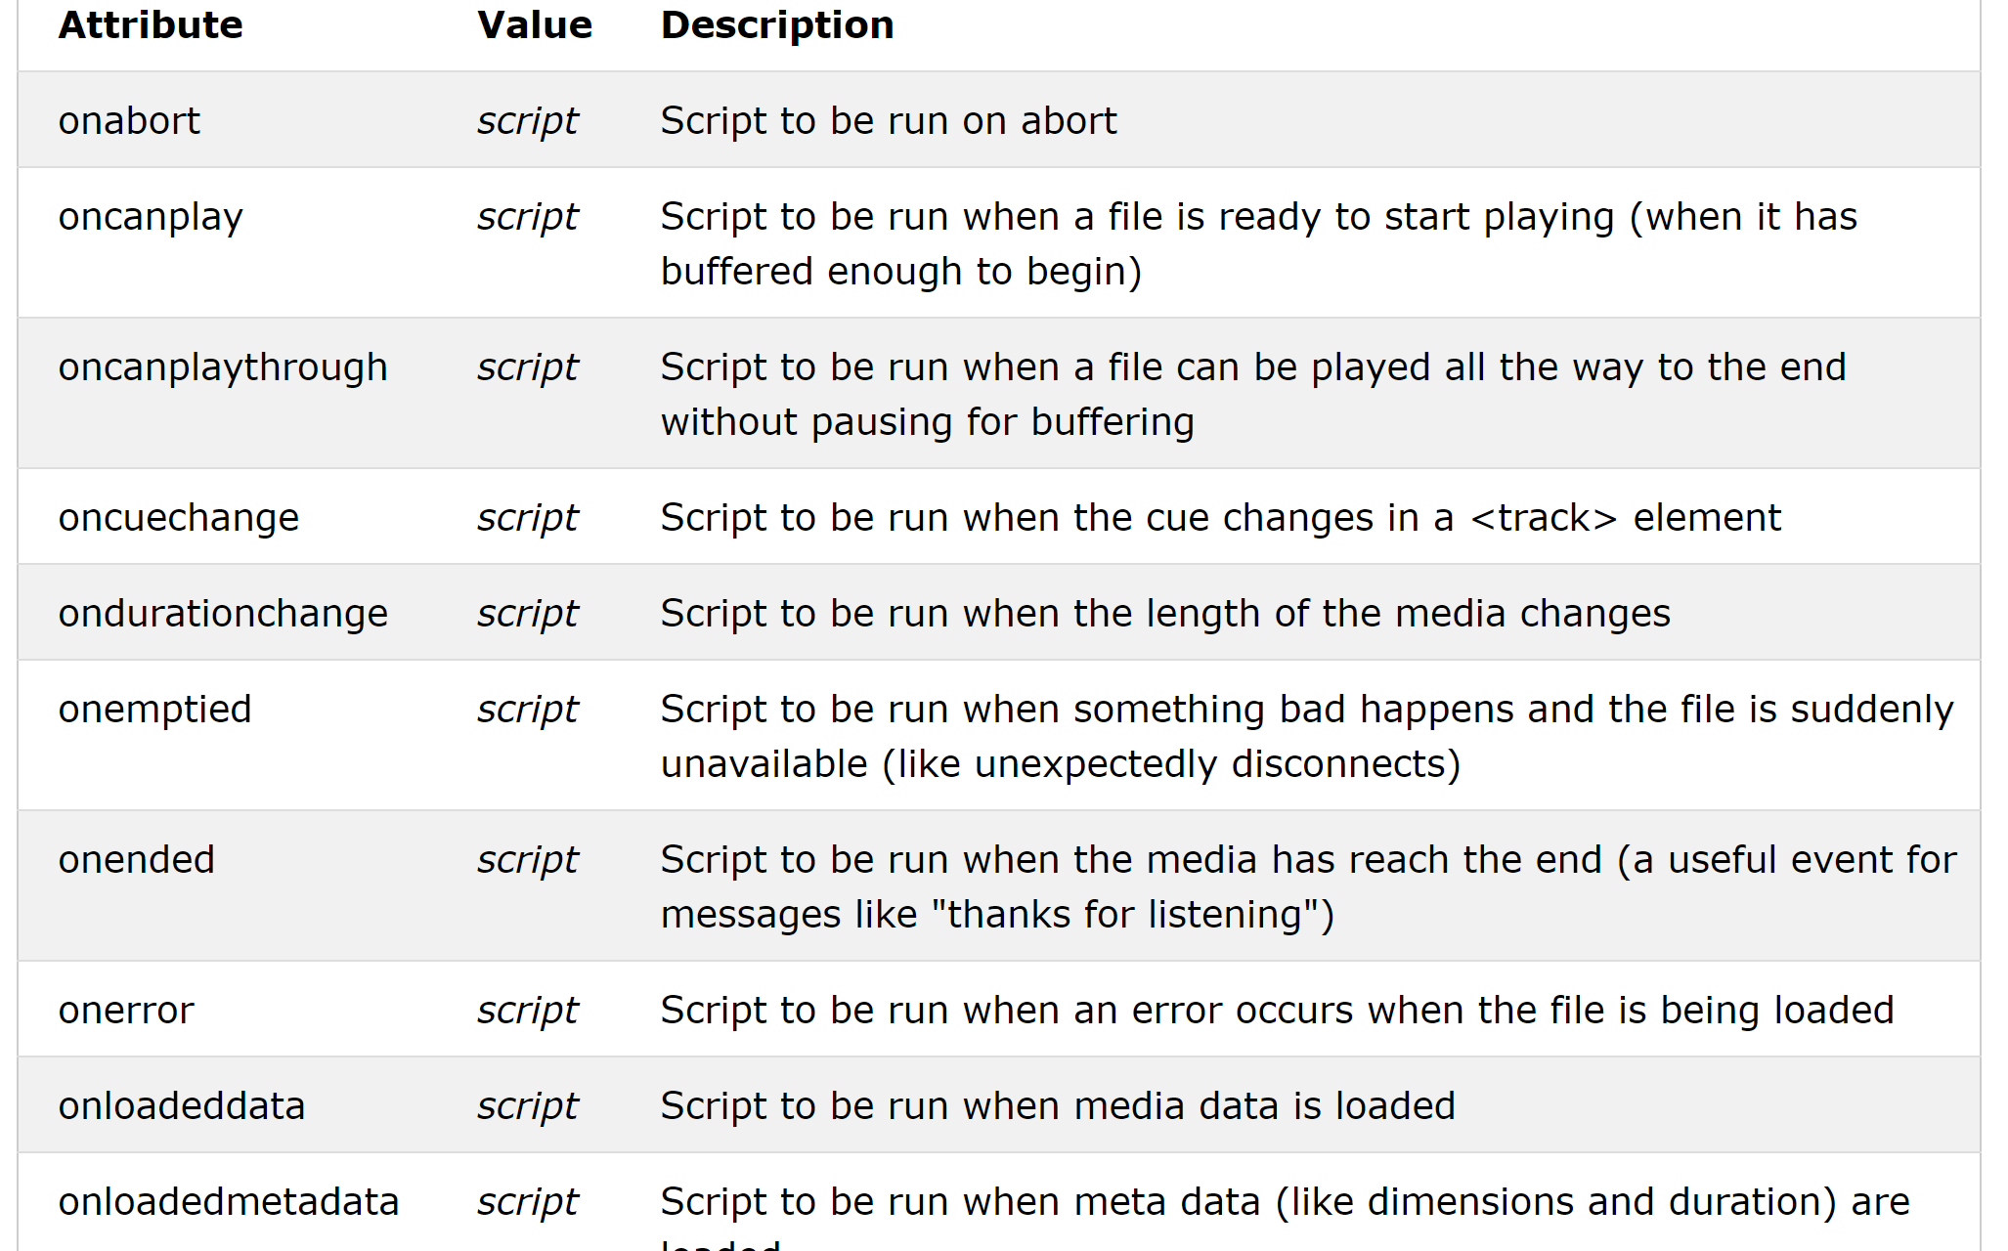
Media Events

Slide 36
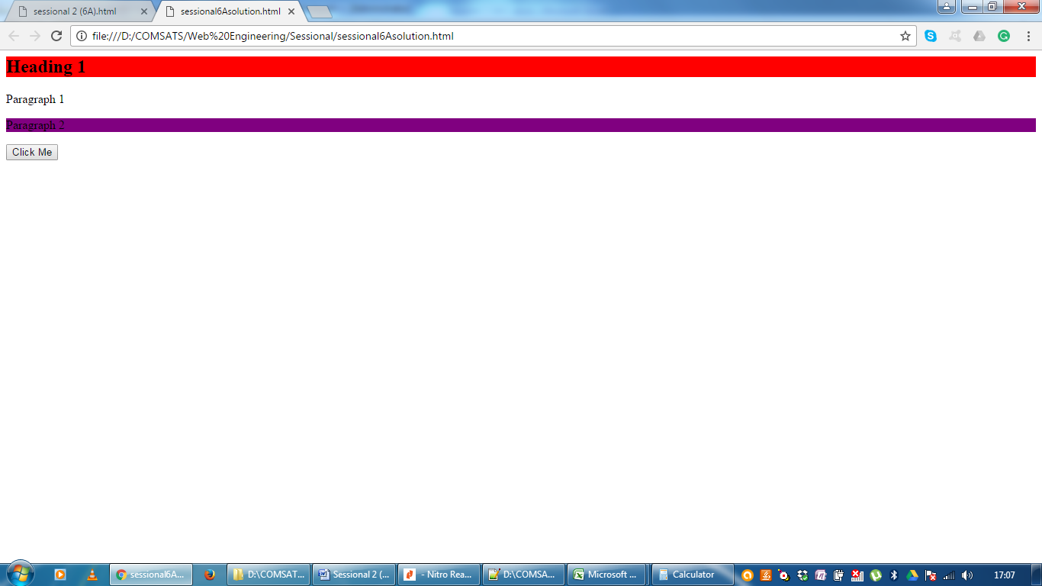
QuerySelectorAll Example
<body>
<h2 class="example">Heading 1</h2>
<div class="main">
<p class="example">Paragraph 1</p>
<p class="child">Paragraph 2</p>
</div>
<button onclick="myFunction()">Click Me</button>
<script>
function myFunction() {
var x = document.querySelectorAll(".example, .main .child");
x[0].style.backgroundColor = "red";
x[2].style.backgroundColor = "purple";
}
</script>
</body>

Slide 37
Summary of Today’s Lecture
Browser Object Model (BOM)
  Window object properties
  Window object methods
  Window Events
Document Object Model (DOM)
  Accessing DOM Nodes
  DOM Events

Slide 38
Resources
Chapter 19 and Chapter 20 from Learning Web Design- A Beginner’s Guide to HTML, CSS, Javascript and Web Graphics By Jennifer Niederst Robbins (4th Edition)
https://www.w3schools.com/tags/ref_eventattributes.asp
https://www.w3schools.com/jsref/met_document_queryselectorall.asp
https://www.w3schools.com/jsref/met_document_queryselector.asp
https://www.w3schools.com/jsref/obj_window.asp

